Slide 1
Dognition Project
File created on: 07-12-2019 15:55:21

Slide 2
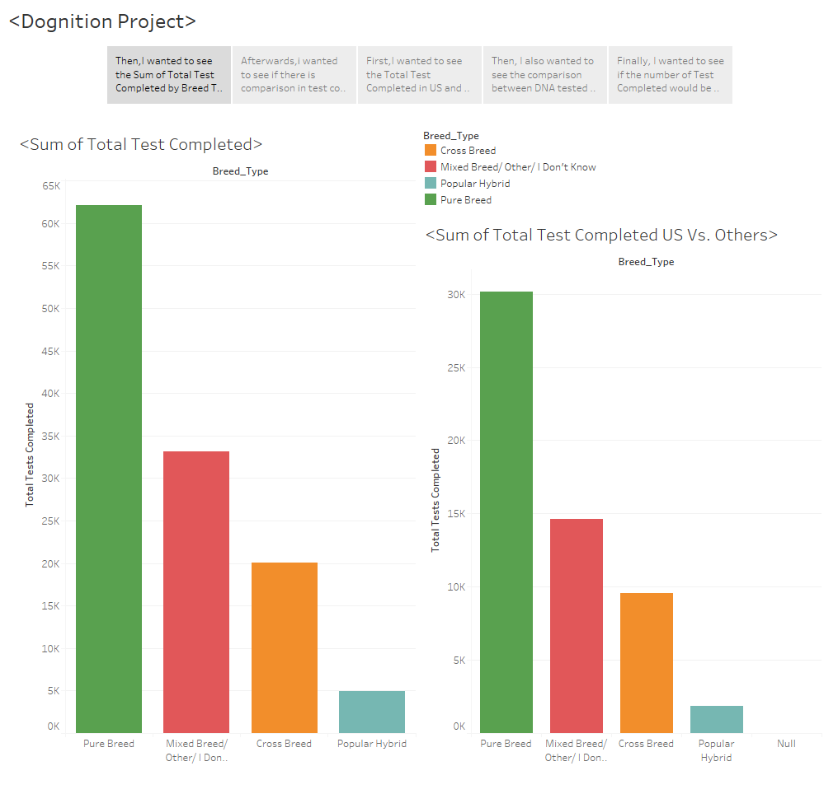

Slide 3
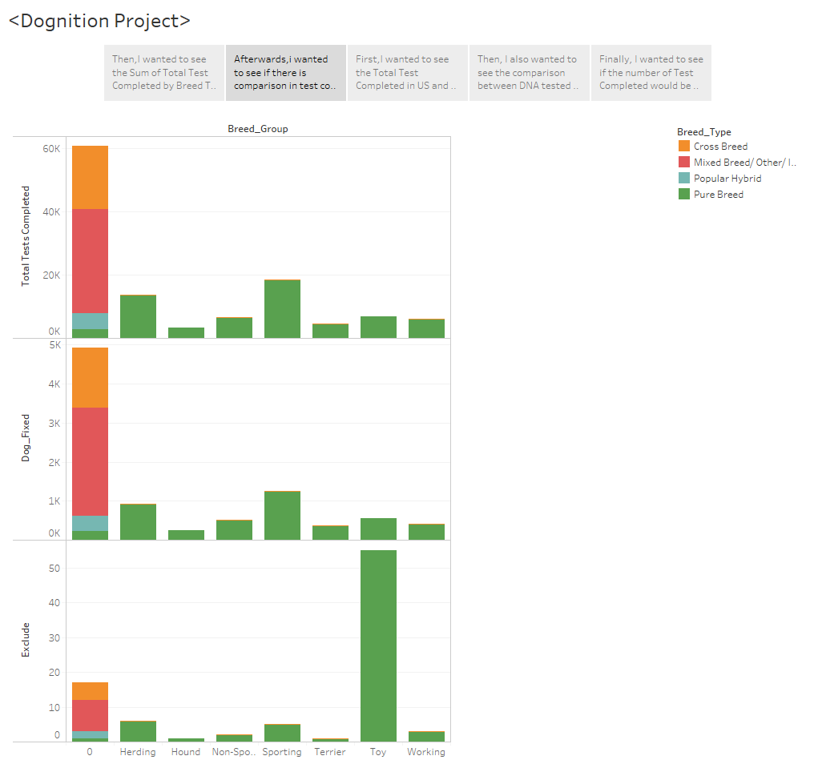

Slide 4
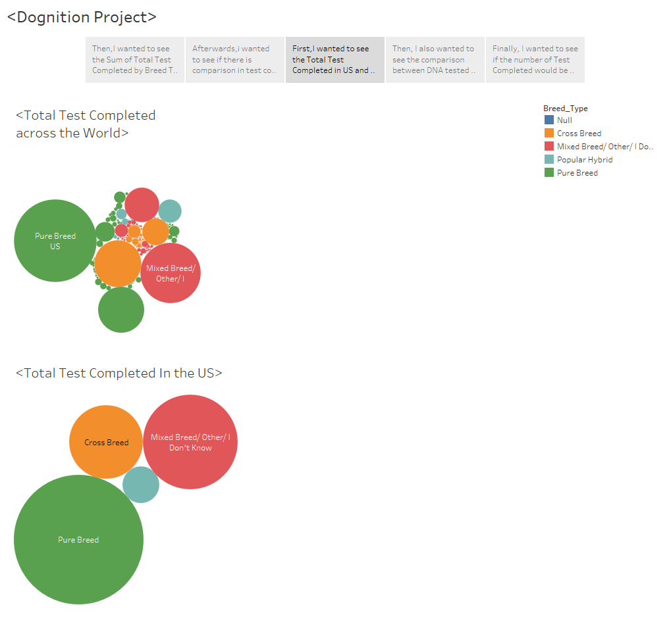

Slide 5
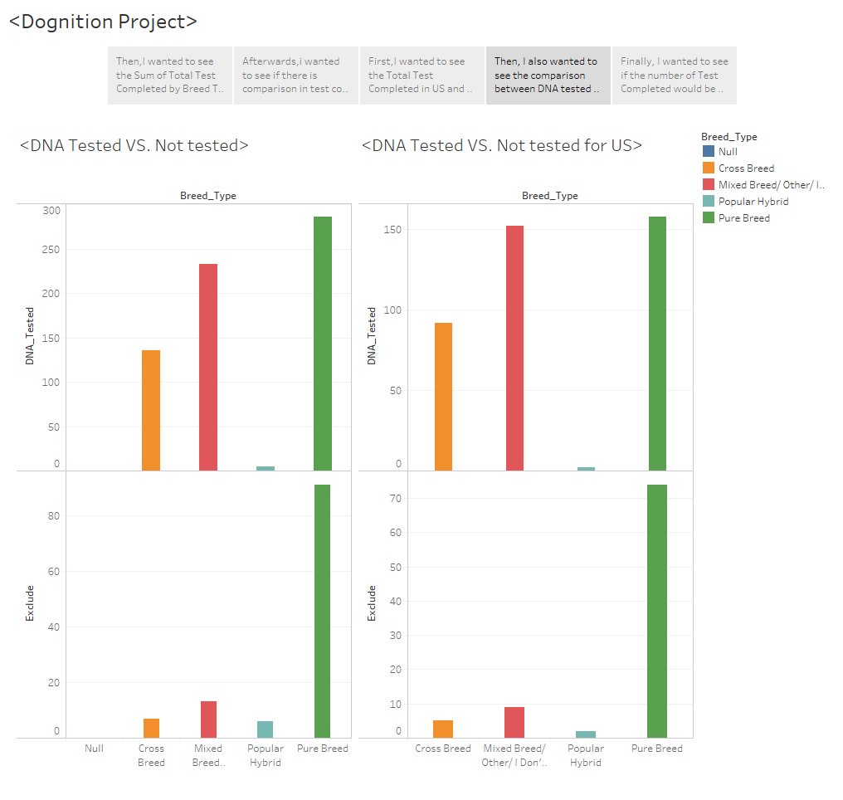

Slide 6
